Slide 1

Precision technology that touches your life.
Every Day
Everywhere.
Precision Dispensing | Fluid Management | Coating & Curing | Testing & Inspection | Surface Treatment

Slide 2
Who we are

Slide 3


Nordson is an innovative precision technology company
that leverages a scalable growth framework to deliver
top tier growth with leading margins and returns.
Company Founded
*Sales
*2025 EBITDA
Employees
Countries with
Direct Presence
1954
$2.8B
32%
8,000+
35+
*Sales and EBITDA for the full fiscal year ended 10/31/25.

Slide 4

By the Numbers
Consistent Record of Growth
Demonstrated Value to Customers
Disciplined focus on profitability
Solid Returns
Differentiated Product Portfolio*
Consistent value to shareholders
6%
Sales Growth
55%
Gross Margins
30%+
EBITDA Margins
12%
ROIC
2,200+
Global Patents Held
62 yrs.
of Annual Dividend Increases
Note: Financial amounts presented are averages of 2020 – 2025, except ROIC, which is 2025, and dividends which updated August 2025 *Active Patents as of 10/31/25

Slide 5
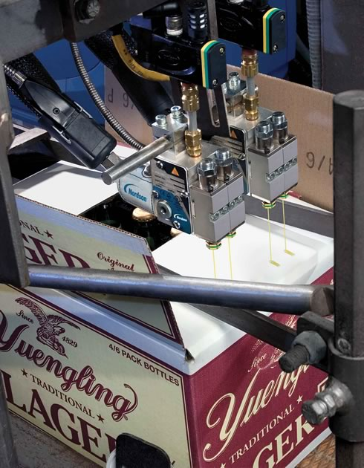
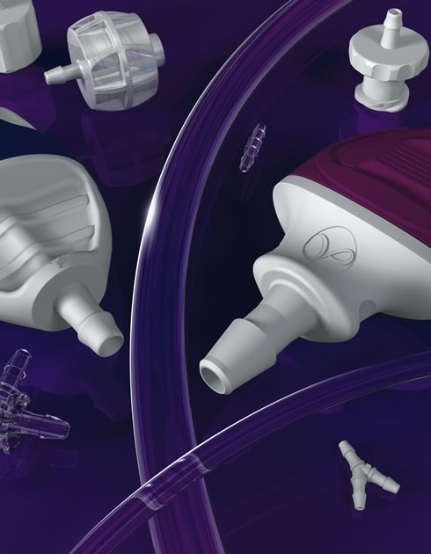
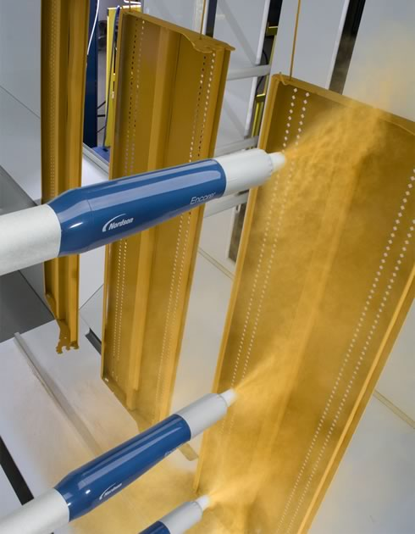
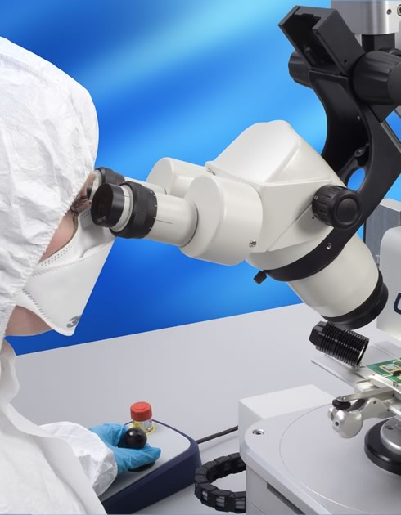
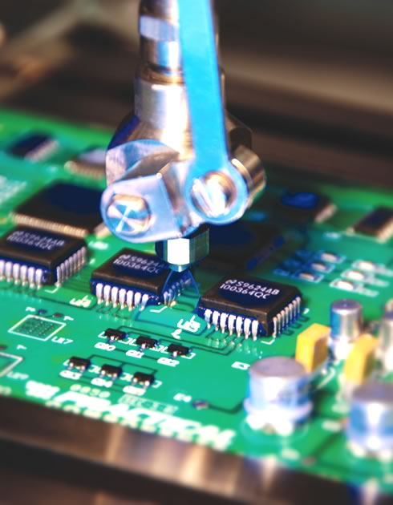
What We Do
PRECISION DISPENSING
FLUID MANAGEMENT
COATING & CURING
TESTING & INSPECTION
SURFACE TREATMENT
Automated high-speed precision dispensing
Conformal Coating
Manual precision dispensing
Product packaging and assembly
Laminating
Plastic extrusion
Injection molding
Hot bar bonding
Selective soldering
Precision dispense components
Medical components and technologies
Powder coating
Liquid painting
Container coating
Cold material dispensing
UV curing
Bond testing
Manual and automated
x-ray
Automated optical inspection
Acoustic microscopy
Plasma cleaning and conditioning

Slide 6



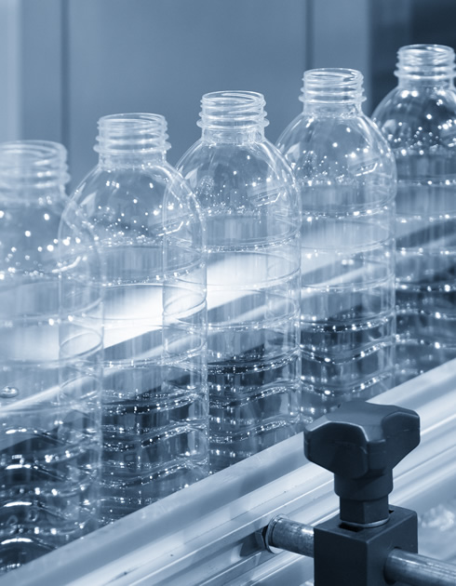

Where You Will Find Us
MOBILE DEVICES
COMPUTERS
FOOD AND
CONSUMER GOODS
PACKAGING
MEDICAL
Mobile phone and tablet assembly
Flat panel displays
Printed circuit boards
LEDs and electronic components
Semiconductor packaging
Electric batteries
PC and laptop assembly
Hard disk drives
Wafer-level packaging
Automotive electronics
Flat panel displays
Printed circuit boards
LEDs and electronic components
Semiconductor packaging
Electric batteries
.
Beverage straw and spot attachment
Convenience food packaging
Baby diapers
Tissues and paper towels
Container and bottle labeling
Box sealing
Inside container coating
Can marking and identification
Tamper evident closure
Balloons, catheters and other minimally invasive devices
Single use fittings, valves, syringes, tips and tubing for controlling fluids in medical equipment and surgical procedures

Slide 7
Our Business

Slide 8


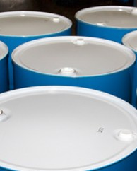
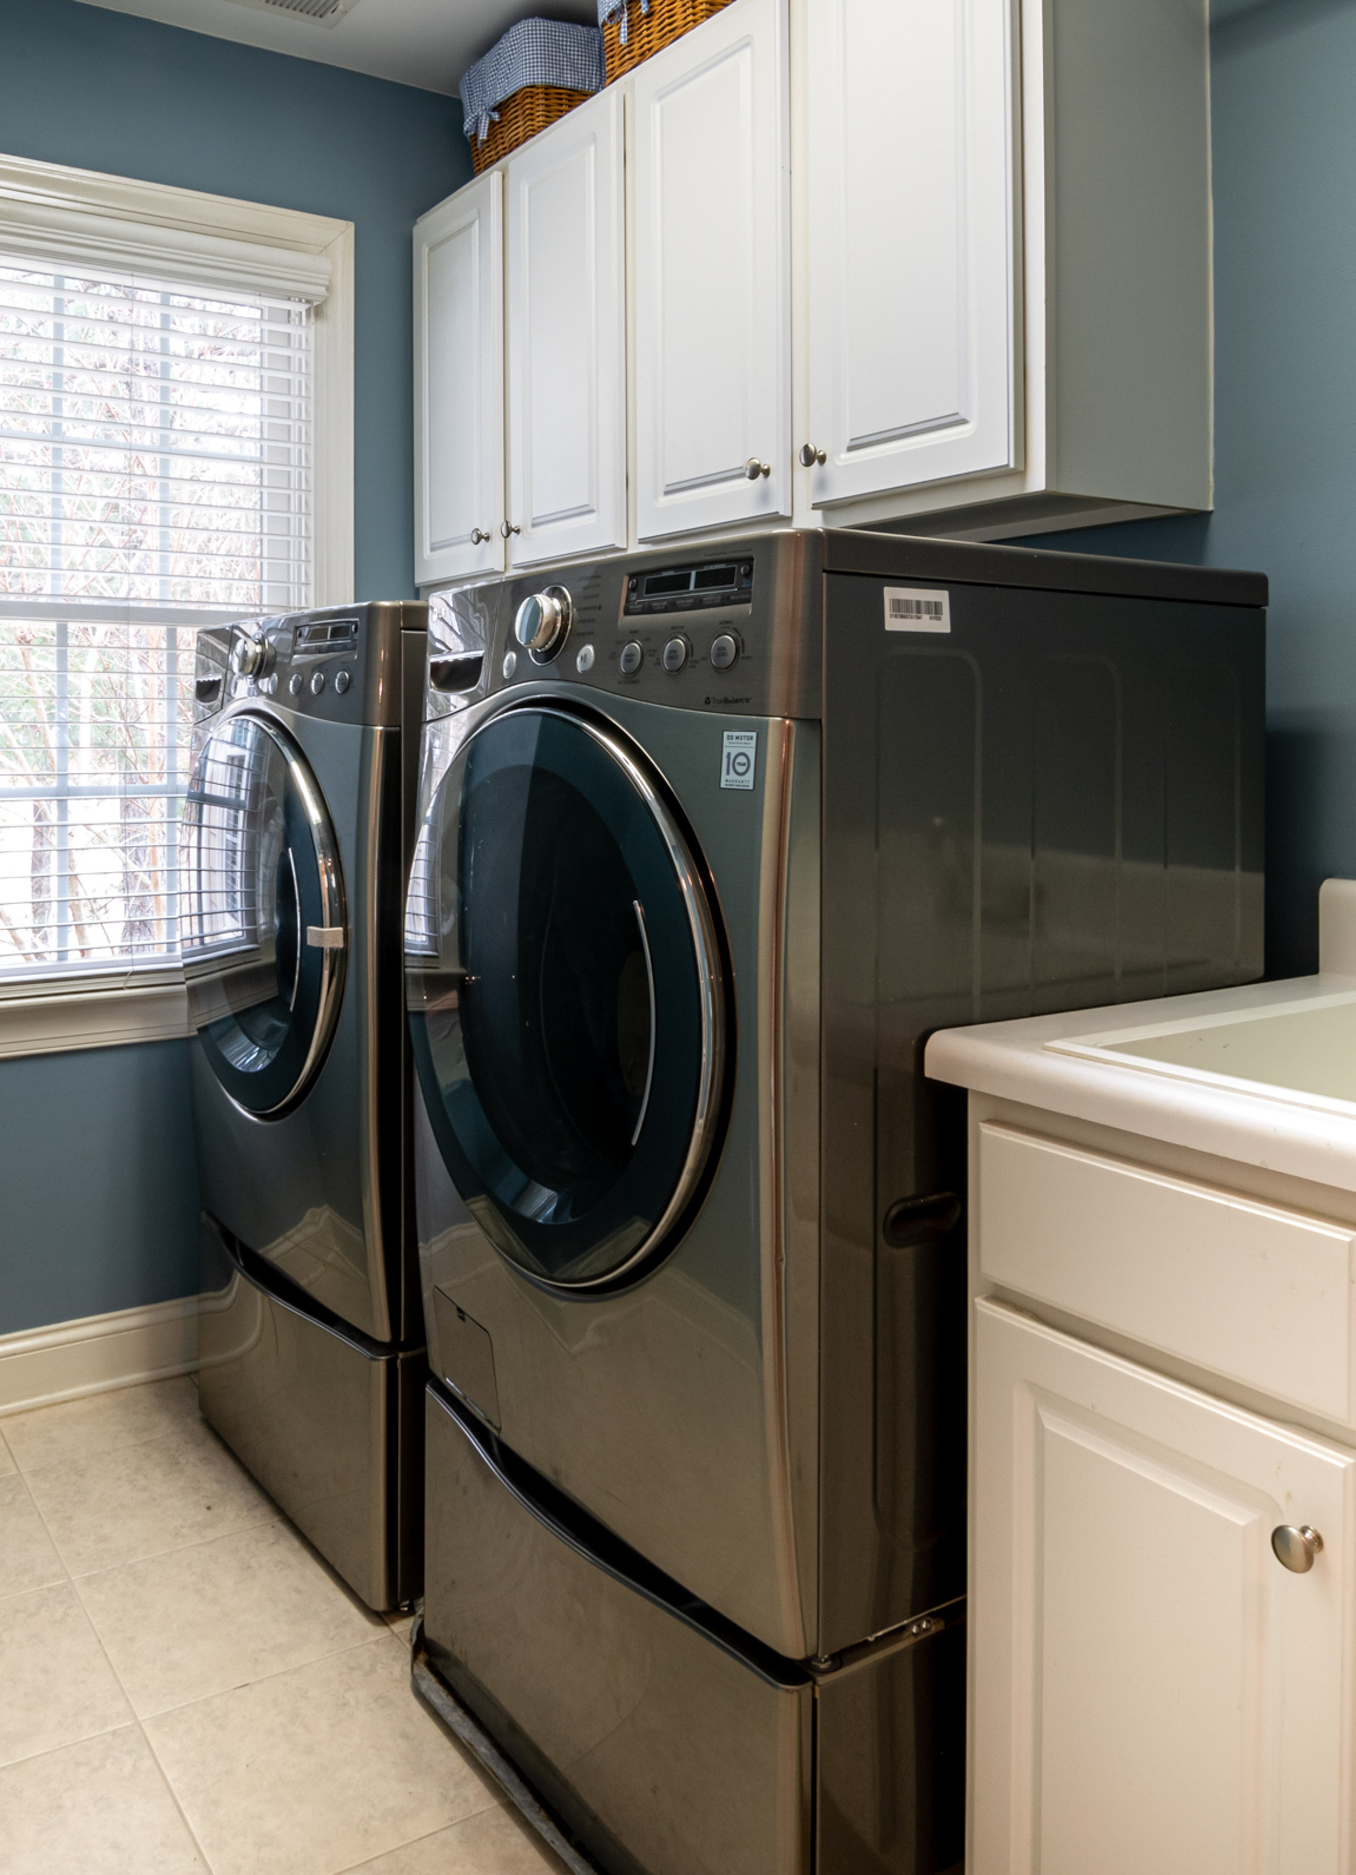
Diversified End Markets
Electronics
27% of revenue
Medical
25% of revenue
Consumer Non-Durable
23% of revenue
Industrial
13% of revenue
Remaining Markets
12% of revenue
Semiconductor packaging
Wafer-level packaging
Printed circuit boards
Electronic component assembly – mobile phone, camera, ear buds, PC
Automotive electronics
Balloons, extrusions, delivery catheters and other minimally invasive devices
Single-use fittings, connectors, fluid transfer components in medical equipment and surgical procedures
Single-use specialty cannula for cardio-pulmonary procedures
Box sealing
Baby diapers
Convenience food packaging
Beverage straw and spot attachment
Container and bottle labeling
Construction and industrial machinery
Rigid container
Aerospace
Chemical
Defense
Energy
Consumer durable
Automotive
Animal health & delivery systems
Agriculture
Data is for directional use only.​

Slide 9
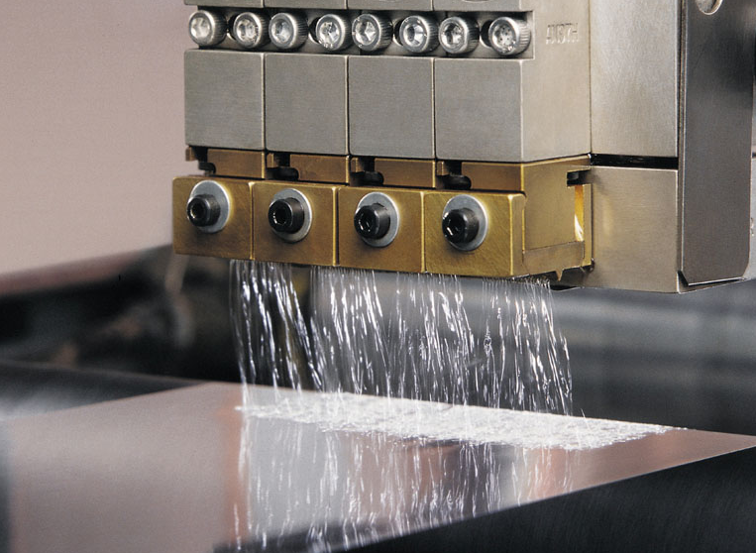
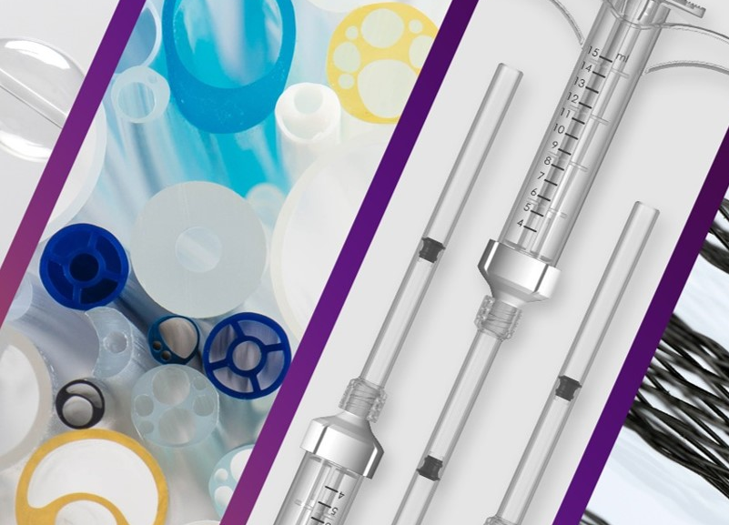
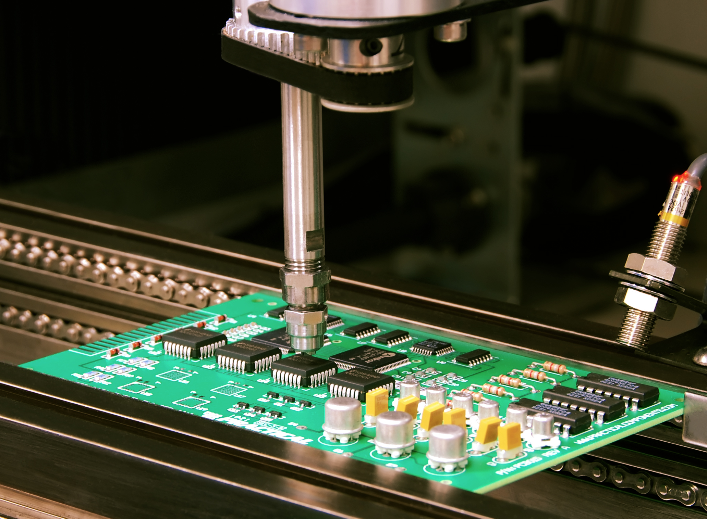
How We Are Organized
INDUSTRIAL PRECISION SOLUTIONS
MEDICAL FLUID SOLUTIONS
ADVANCED TECHNOLOGY SOLUTIONS
Precision Adhesives Dispensing, Industrial Coatings,
Polymer Processing & Precision Agriculture
Interventional Solutions, Fluid Components ​
& Engineered Fluid Dispensing
Electronic Processing Systems
& Test and Inspection
48%
REVENUE
30%
REVENUE
22%
REVENUE
*Segment average mix for the full fiscal year ended 10/31/25

Slide 10
Industrial Precision Solutions (IPS)
What We Do: Product lines reduce material consumption, increase line efficiency, and enhance product brand and appearance.
Components are used for dispensing adhesives, coatings, paint, finishes, sealants and other materials. This business primarily serves
the industrial, consumer durables and non-durables markets.
Fiscal 2025 Revenue
Fiscal 2025 EBITDA
Strategic Focus
New applications for secular trends, including electric vehicle battery, advanced packaging, automotive and solar
Material, machinery and process innovations
Leverage aftermarket opportunity with the large systems installed base
$1.3B
37%

Slide 11
Medical Fluid Solutions (MFS)
What We Do: Fluid management solutions for medical, high-tech industrial and other diverse end markets. Related plastic tubing, balloons, catheters, syringes, cartridges, tips, and fluid connection components are used to dispense or control fluids within customers’ medical devices or products, as well as production processes.
Fiscal 2025 Revenue
Fiscal 2025 EBITDA
Strategic Focus
Differentiated single-use component solutions and devices:
  Surgical solutions, including
  minimally invasive
  Medical fluid management components
  Medical device manufacturing
  Industrial technologies
Driving growth through differentiated products in defined market niches
Scaling through M&A, both platform and technology tuck-in
$835M
37%

Slide 12
Advanced Technology Solutions (ATS)
What We Do: Design and develop proprietary technologies found in progressive stages of an electronics customer’s production processes, such as surface treatment, precisely controlled dispensing of material and test, inspection and measurement to ensure quality and reliability.
Fiscal 2025 Revenue
Fiscal 2025 EBITDA
Strategic Focus
Semiconductor front-end manufacturing process
Semiconductor advanced packaging process
Automotive electronics market
Deploy NBS Next to expand our margins and position us for growth
$625M
24%

Slide 13
Our History

Slide 14
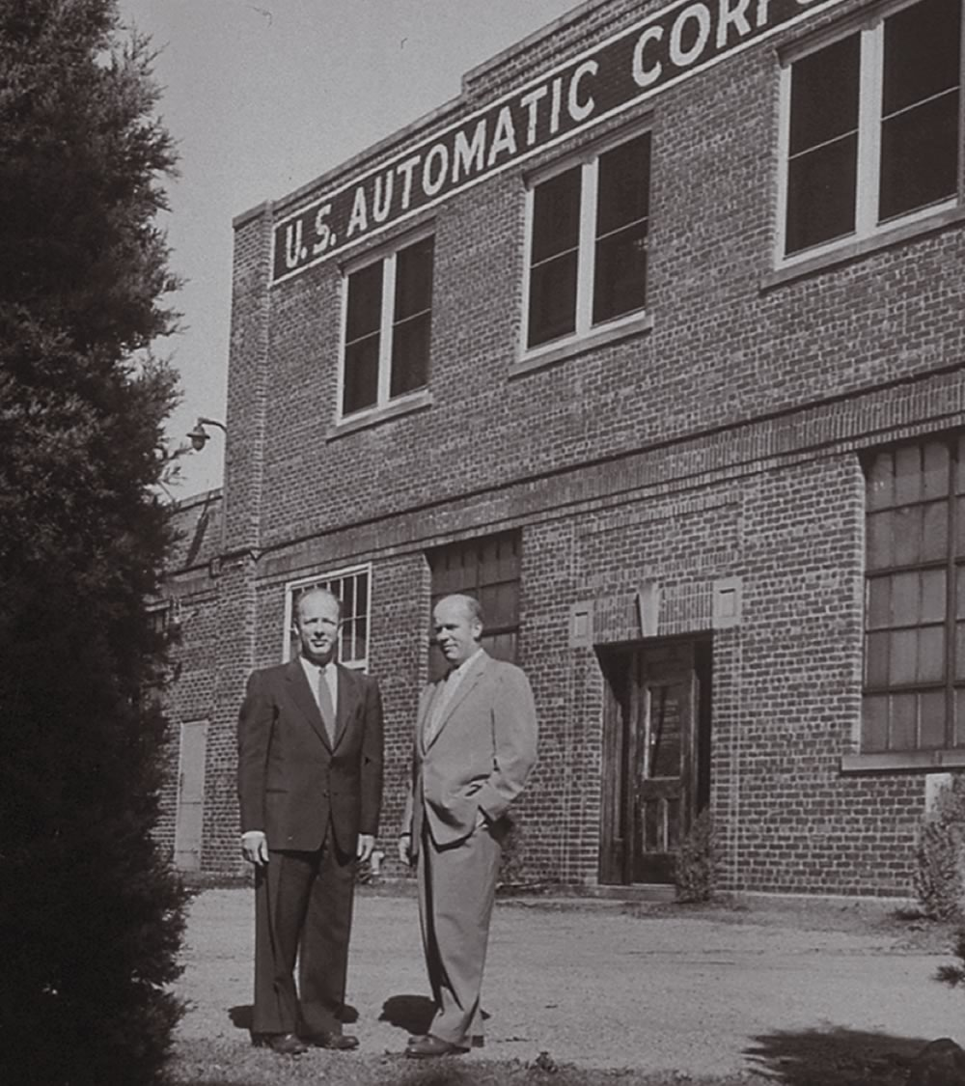
Nordson Corporation was founded
in 1954 in Amherst, Ohio, by brothers
Eric and Evan Nord. However, the
company’s roots trace back to the U.S. Automatic Corporation, which began
in 1909.

Slide 15
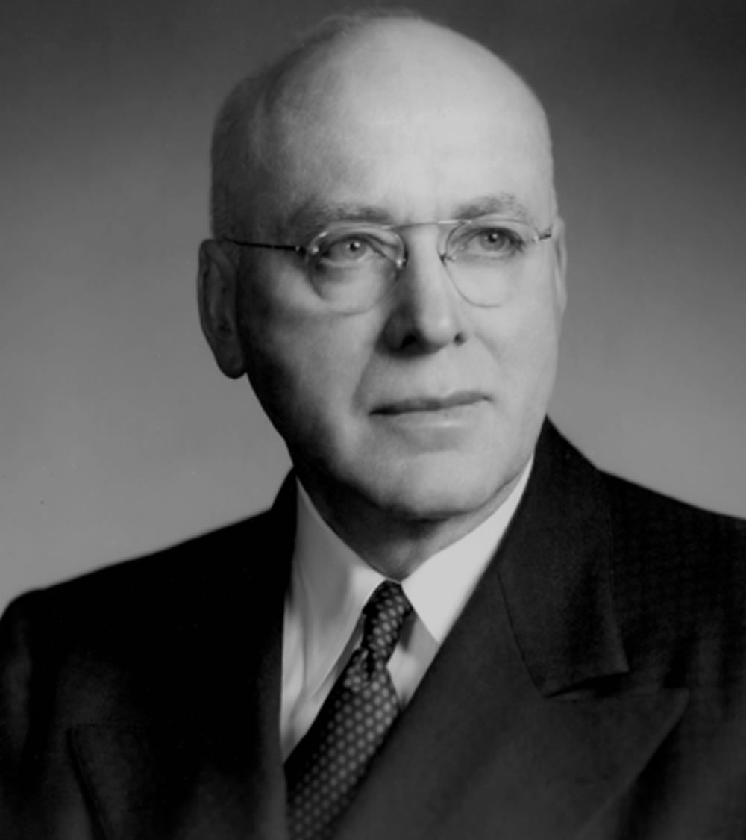
Under the direction of Walter G. Nord,
the company shifted its production
emphasis to lower-volume, high-precision
parts that were critical in supporting
the United States' defense effort during World War II.

Slide 16
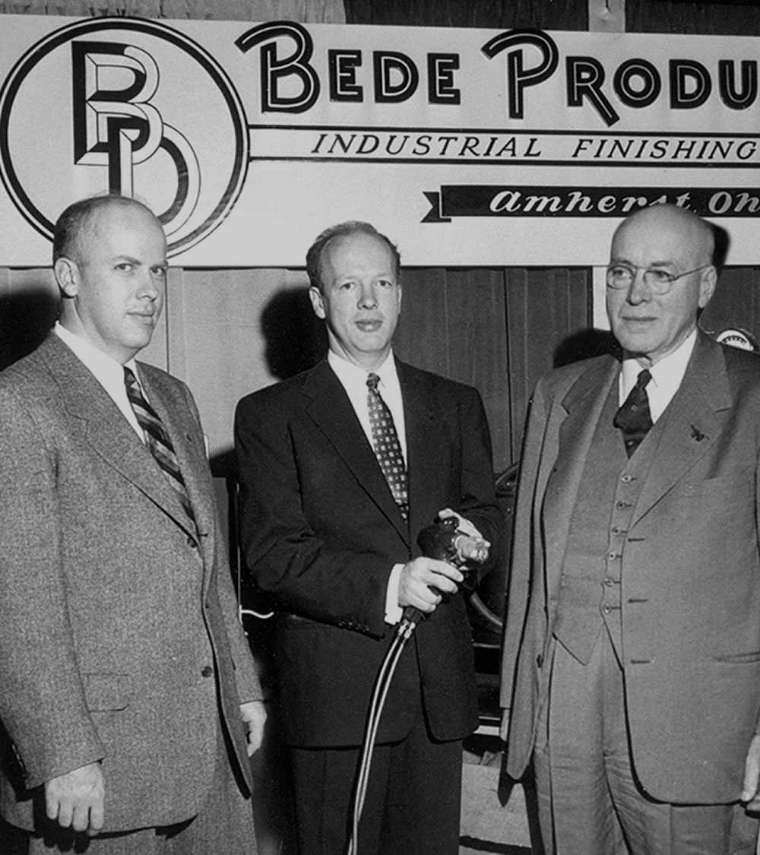
Following the war, the Nords searched for a proprietary product to serve as a basis for future growth. This product was found in 1954 with the acquisition of patents covering the "hot airless" method of spraying paint and other coating materials. With the patents in hand, Nordson was started as a division of U.S. Automatic Corporation to produce and market airless spray equipment.

Slide 17
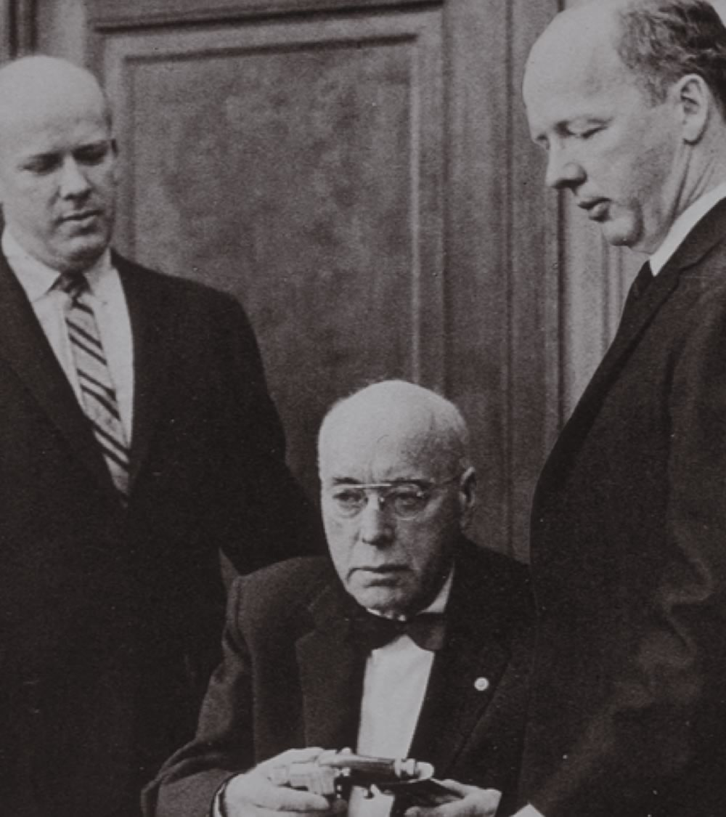
From the outset, Walter G. Nord
and sons Eric and Evan established a corporate philosophy built on entrepreneurship, innovation and philanthropy. These virtues remain
at the core of our identity today.

Slide 18
“My hope for Nordson is that we continue to be a venturesome company, operating somewhere out on the leading edge…
This can only happen if we continue to encourage innovators and entrepreneurs.”
- Co-founder Eric Nord (1917-2008)

Slide 19
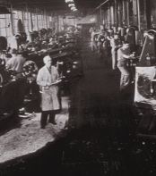
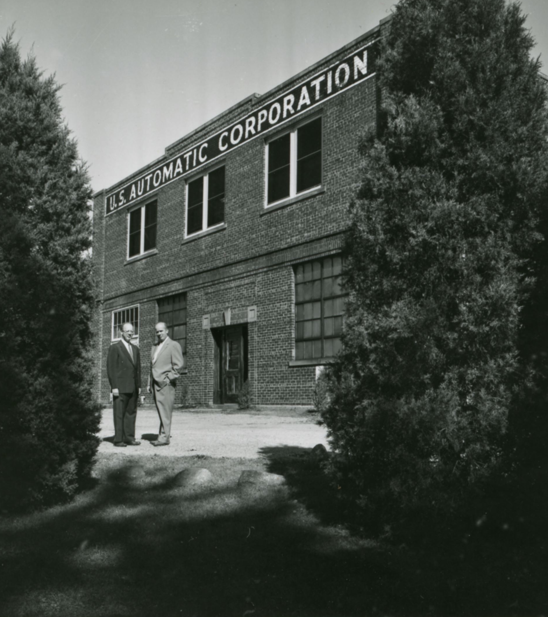
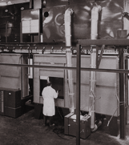
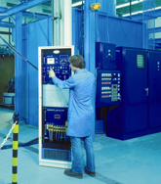
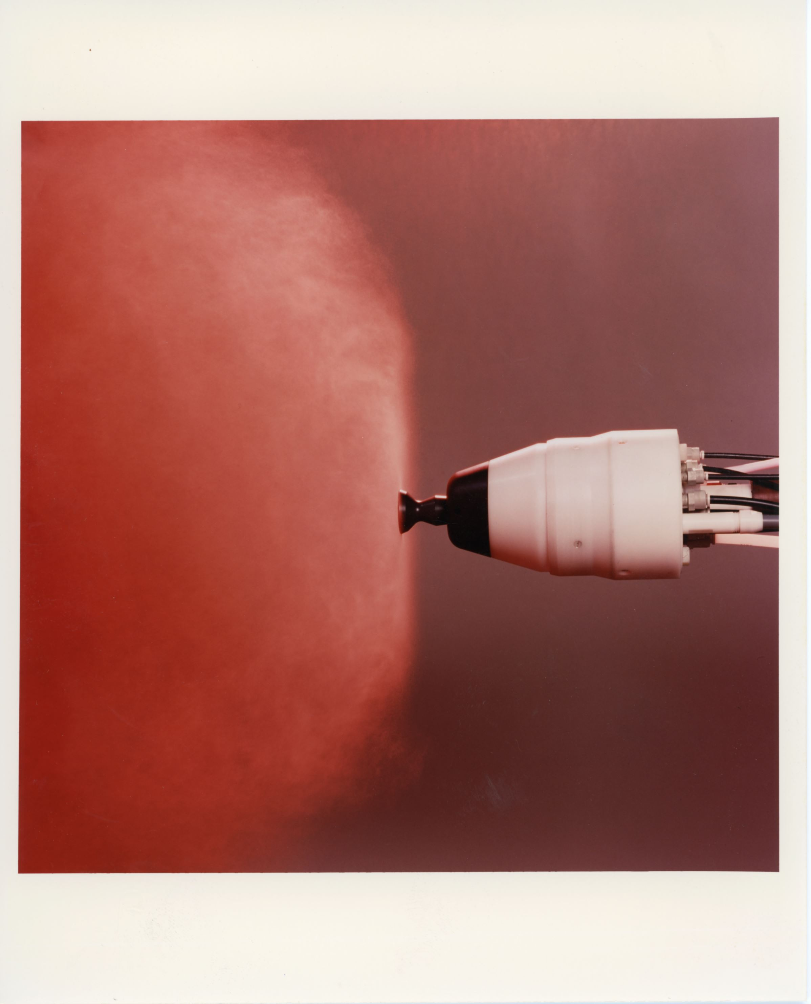
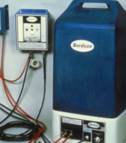
1950s
1960s
Following WWII, the Nords searched for a proprietary product to serve as a basis for future growth. This product was found in 1954 with the acquisition of patents covering the "hot airless" method of spraying paint and other coating materials. With the patents in hand, Nordson was started as a division of U.S. Automatic Corporation to produce and market airless spray equipment.
In 1966, the entire U.S. Automatic operation was merged into the subsidiary, Nordson Corporation. Nordson pioneered the technology and equipment for applying powder coatings with the development of the compact and efficient cartridge-type recovery/recycle systems. The first Nordson international subsidiaries were established in Europe and Asia. Total company sales reached $10 million.

Slide 20
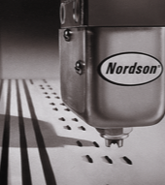
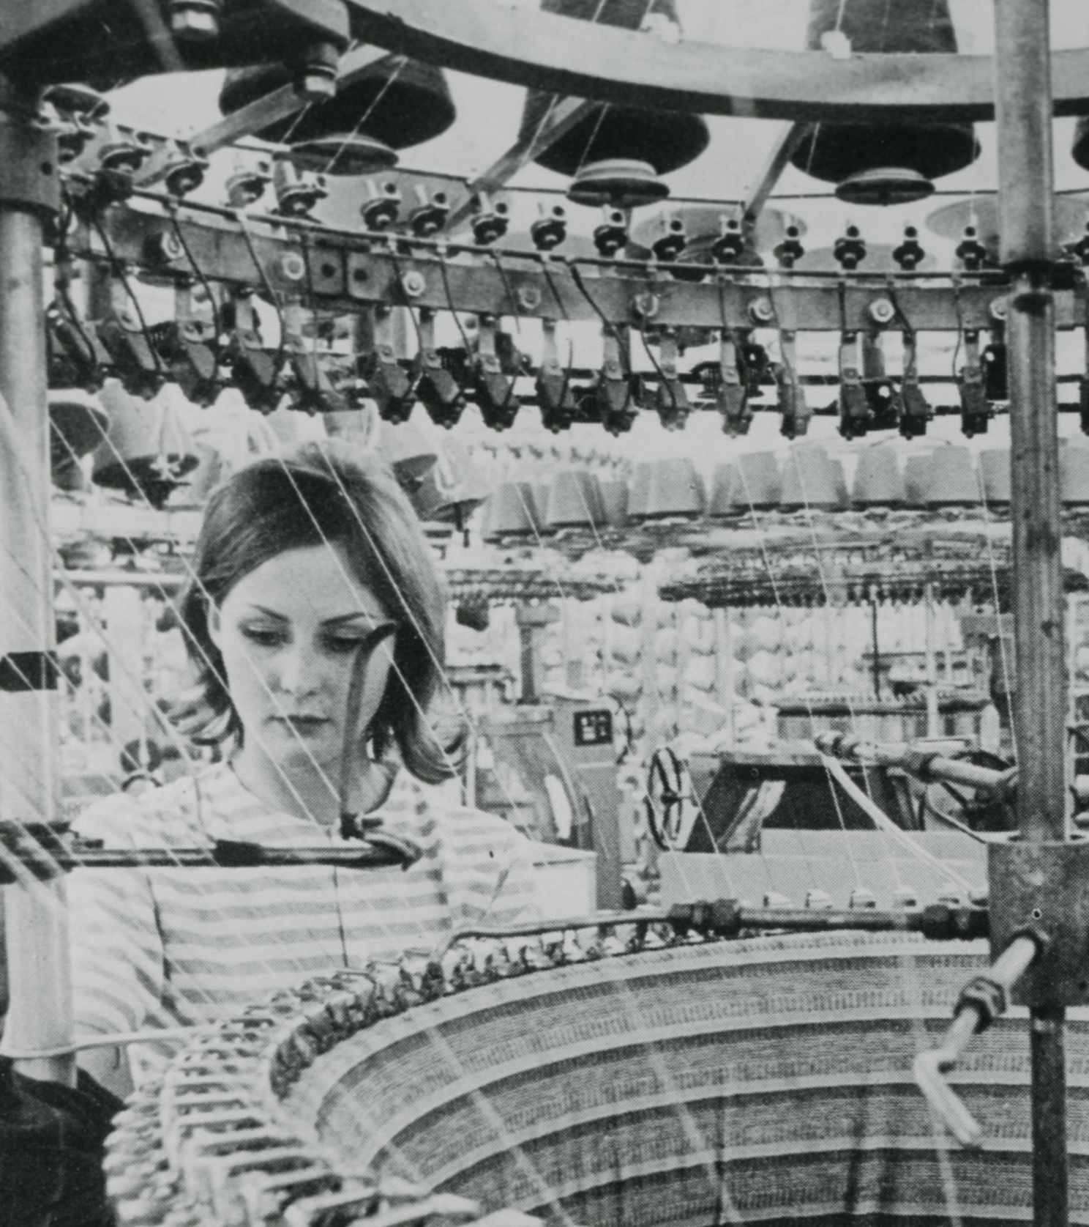
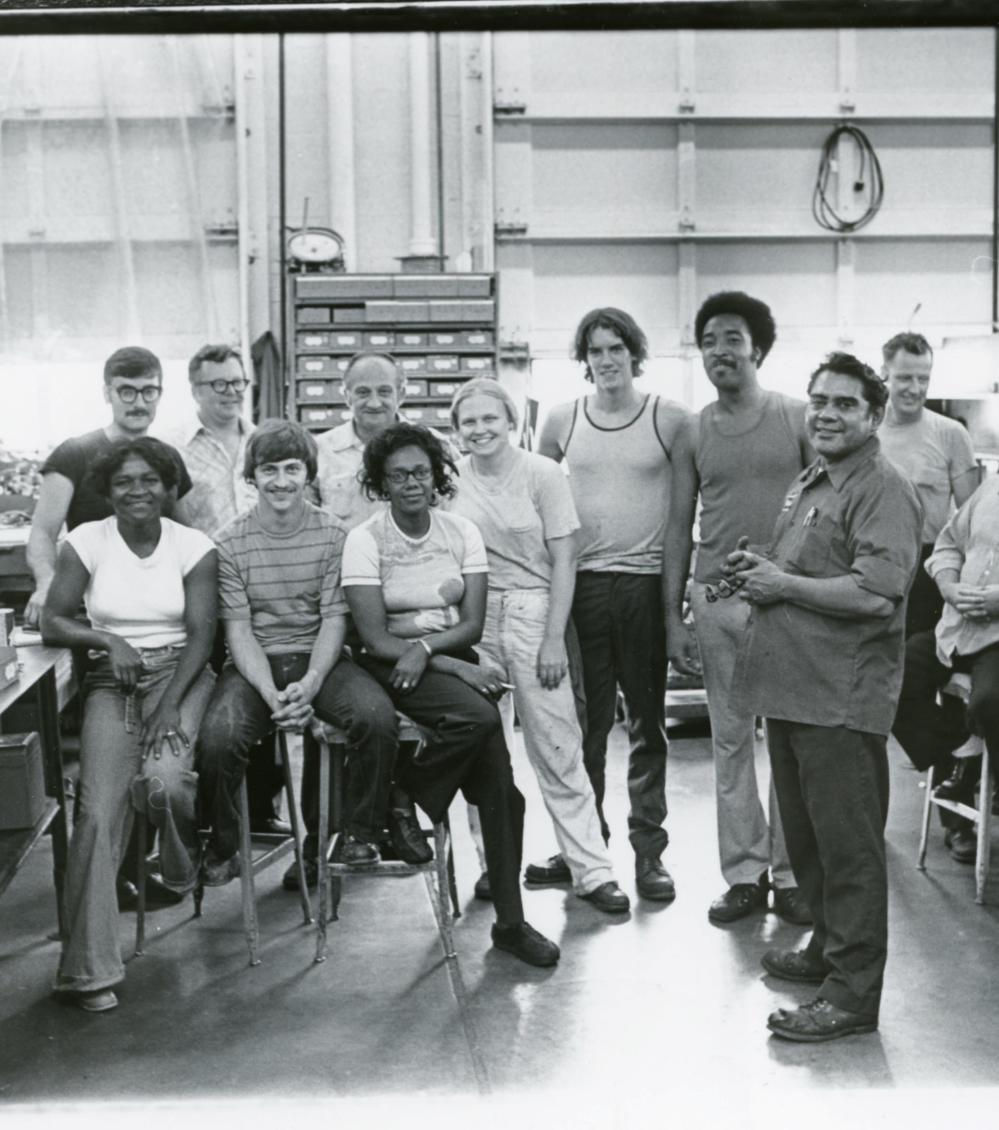
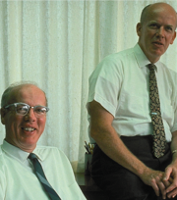
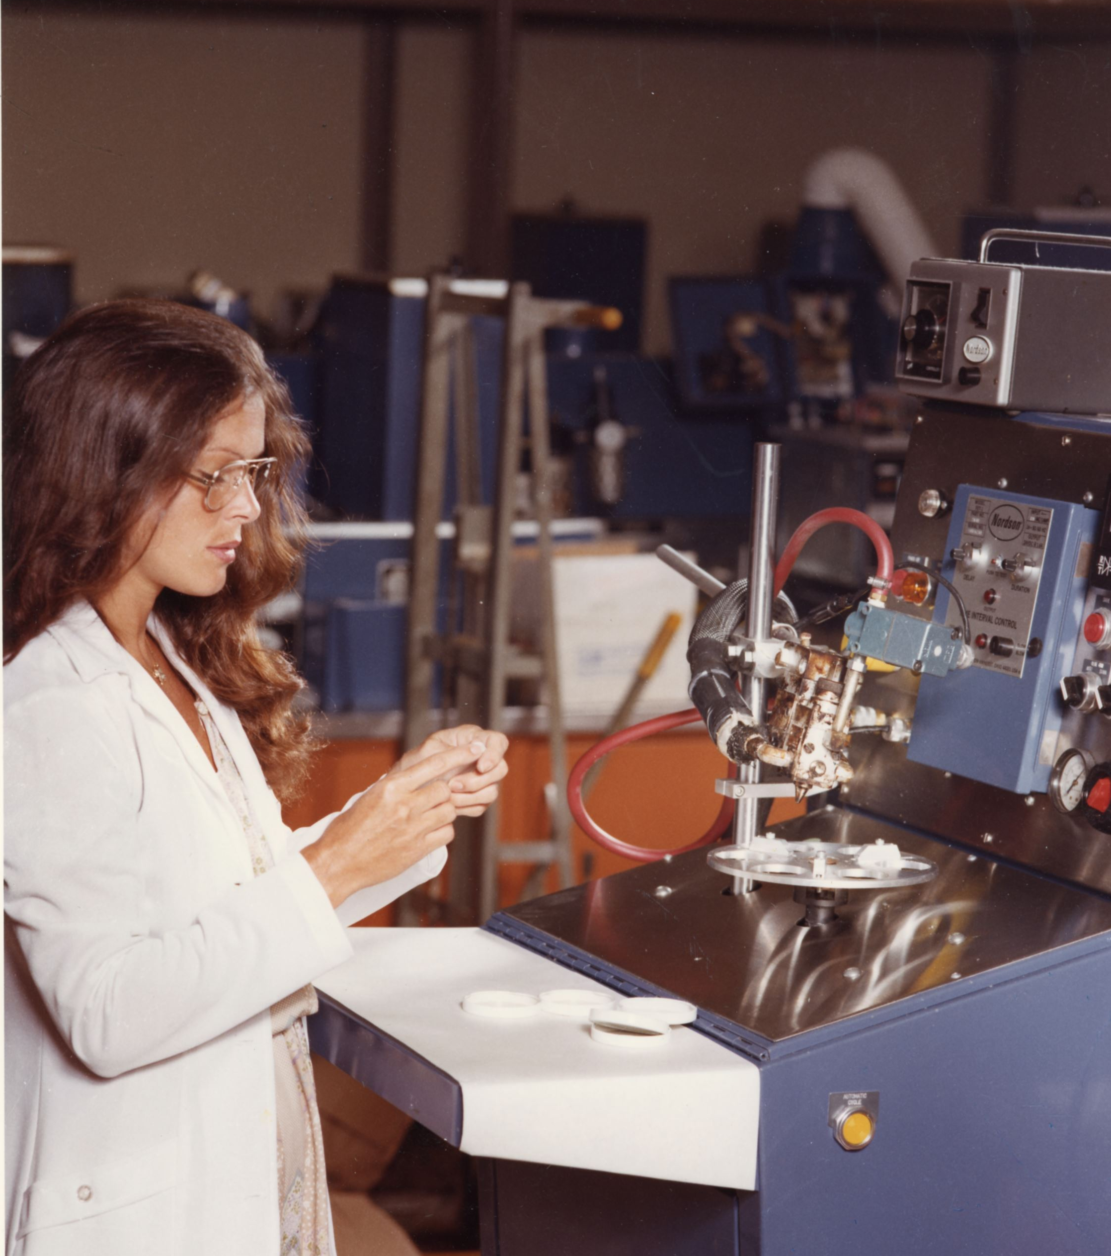
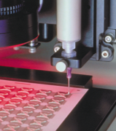
1970s
1980s
Nordson continued to build on the innovations of the previous decade. Under the leadership of Eric Nord, the company exceeded $100 million in sales. Shares of Nordson began to be traded on the NASDAQ exchange.
Nordson began to acquire companies that would strengthen its position as a leader in technology, product quality and customer service. The company’s first Latin American subsidiary was established in Brazil. International sales reached more than 50% of the company’s $250 million in annual revenue.

Slide 21
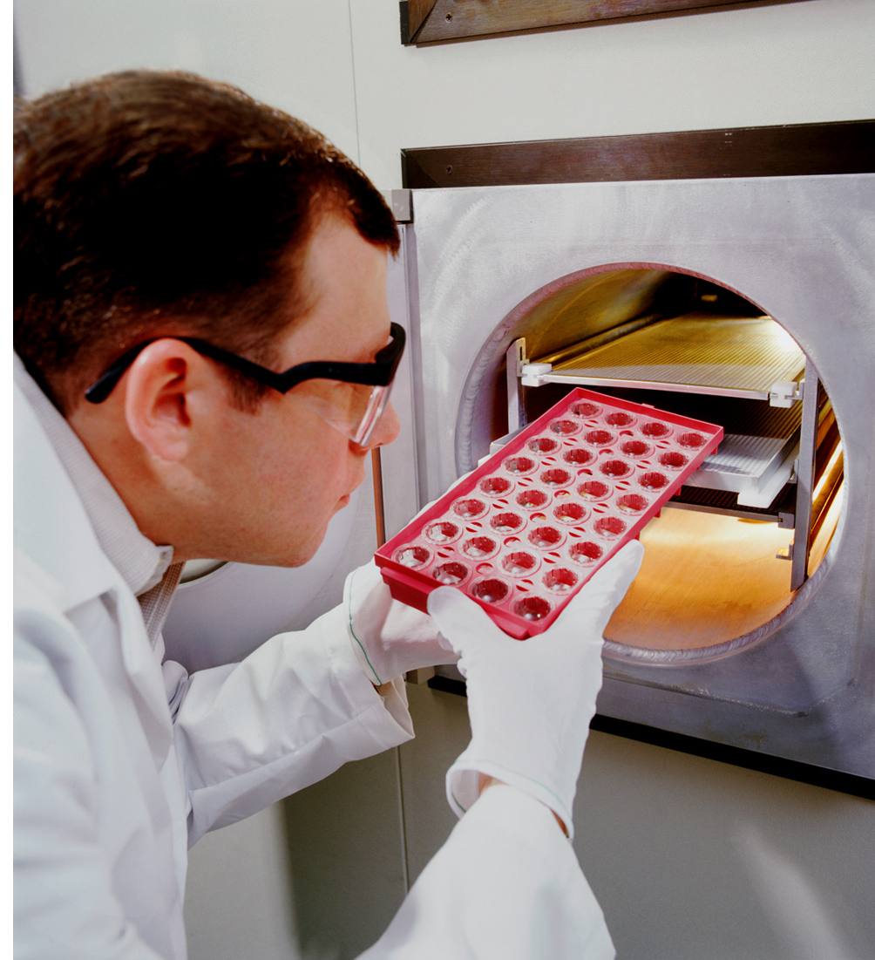
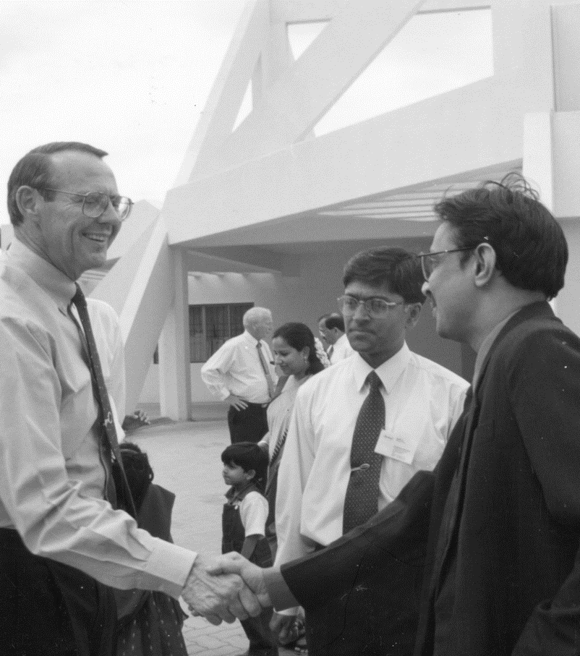
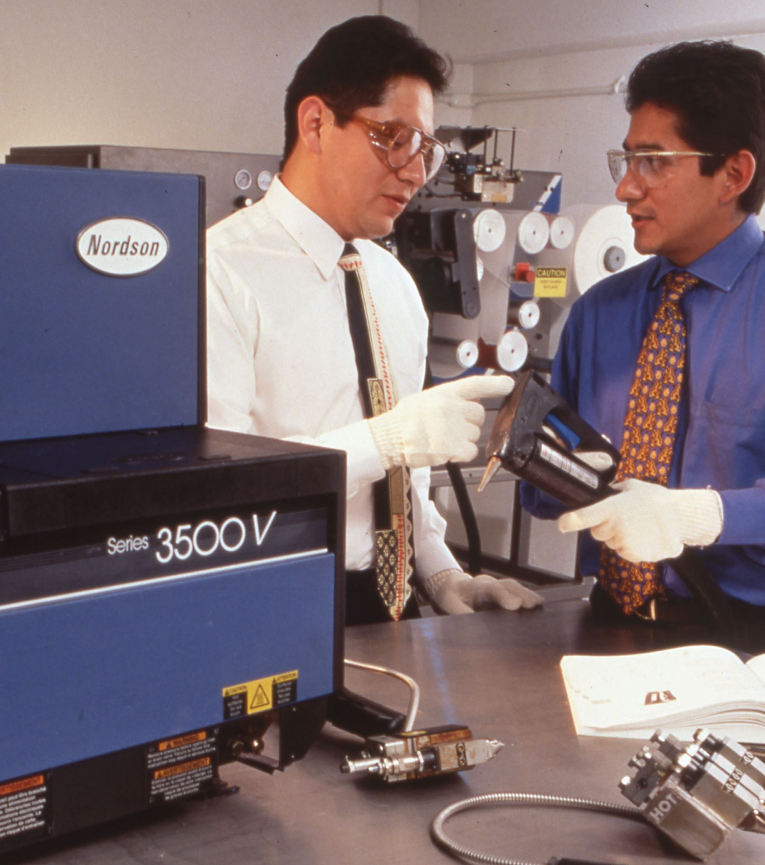
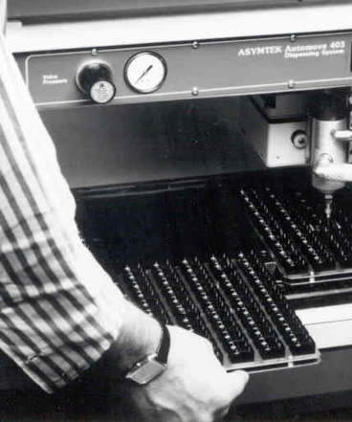
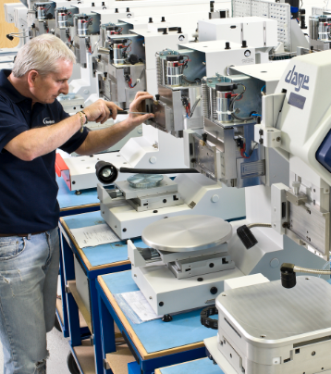
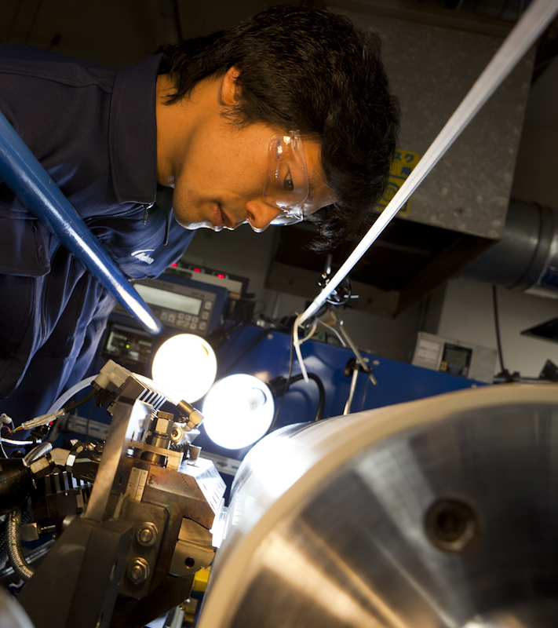
1990s
2000s
Nordson continued to grow organically and via acquisition. The company began to expand its presence in emerging high technology and electronics industries. By the end of the decade, sales exceeded $500 million and subsidiaries were established in China and India.
Multiple acquisitions expand dispensing capabilities and provide entry into test and inspection markets. Global market share expands as Nordson increases focus on technology differentiation, lean manufacturing, application expertise and direct service. Sales exceed $1 billion.

Slide 22
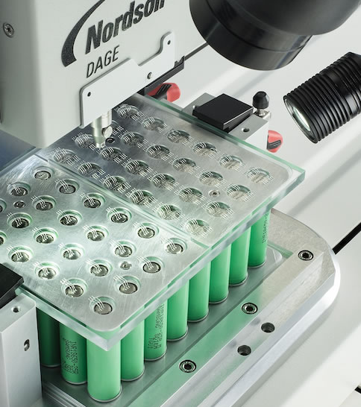
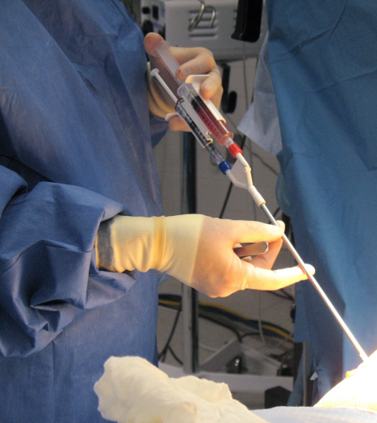
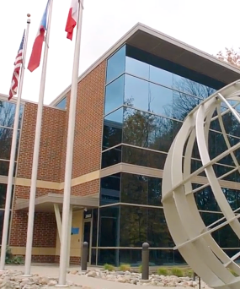
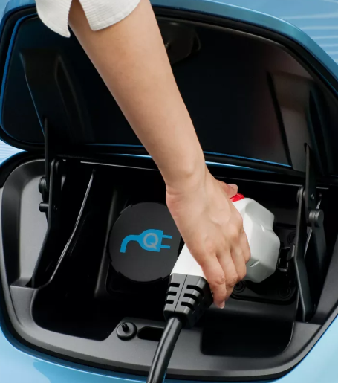
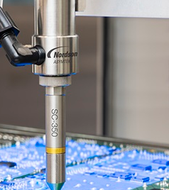
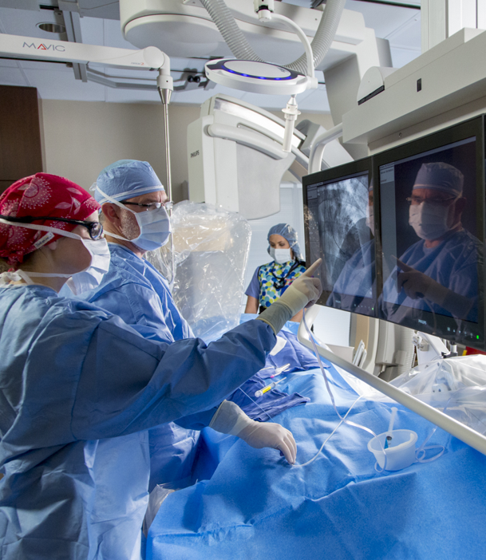
2010s
2020s
Nordson continues to grow via new products, new applications and new markets, including medical, test and inspection, and polymer processing. Strategic acquisitions bring additional growth. The company strengthens its position as the global leader in precision technology solutions.
In August 2019, Nordson welcomed Sundaram Nagarajan as our president and chief executive officer. In 2021, Nordson launched the Ascend Strategy, designed to deliver top-tier growth with leading margins and returns. The company also continues to grow through acquisitions, including the acquisitions of ARAG and Atrion Corporation.

Slide 23
Community Outreach

Slide 24
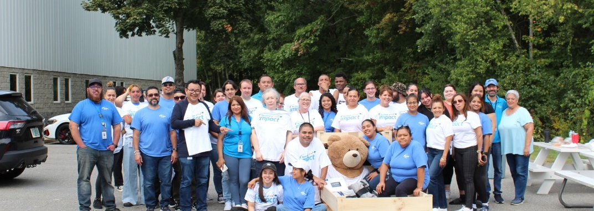

We have a long and proud history of giving back
to the communities where we live and work.
$183M+
121K
$8.1M
17/10
Overall Giving
to Date
Total Hours Volunteered
Towards BUILDS Scholarships
Communities/ Countries Where
We Give Back

Slide 25








At Nordson, we have a long and proud history of giving back to the communities where we live and work. As we grow, we continue to positively impact more people each year through volunteering, donations, scholarships and more. We encourage all employees to make a difference in our communities in the ways that are most meaningful to them. We provide opportunities to get involved through six community engagement programs that together create The Nordson Impact.
Nordson Corporation Foundation
Time ‘n Talent
A Time to Give
Nordson BUILDS Scholarships
Matching Gifts
Nordson Corporate Donations

Slide 26
Nordson Corporation Foundation
The Nordson Corporation Foundation awards grants to non-profits in our communities in the United States. Since 1989, the Foundation has awarded more than $118.1 million in grants to improve the quality of life in our communities, placing a special focus on causes related to education.​

Slide 27
Time ‘n Talent
Time ‘n Talent represents Nordson’s employee volunteer efforts worldwide. Since 2014, employees have logged more than 67,000 hours organizing and participating in projects in their communities.

Slide 28
A Time to Give
A Time to Give is our annual employee giving campaign in the
United States. Since 2006, our yearly campaigns have raised over $5 million for our communities.

Slide 29
Nordson BUILDS Scholarships
Nordson BUILDS Scholarships support college students in our communities in the United States who are pursuing majors related to manufacturing. Since the program’s inception in 2013, $6.5 million has been awarded to over 1,651 scholarship recipients.

Slide 30
Matching Gifts
Matching Gifts the donations Nordson employees make to non-profit organizations in the United States 3:1. In 2025, we made matching contributions of $1.8 million.

Slide 31
Nordson Corporate Donations
Nordson’s corporate donations support programs around the world
that fall outside the bounds of the Nordson Corporation Foundation. During the last financial year, Nordson gave $2.5 million in
corporate donations.

Slide 32
To be truly fit, we must exercise our
‘giving’ muscles.
- Evan Nord

Slide 33
Culture
& Values

Slide 34
Our unique culture is built around people, not just the work we do. Life at Nordson is about empowering possibilities, building connections and finding purpose in every step of the journey.
How It Feels
Our Employee Experience
There’s something truly special about working at Nordson. You’ll feel it in the
way ideas are encouraged, how we support each other and the difference
we make together.
What Guides Us
Our Values
At the heart of Nordson are core
values that never waver. They guide
how we treat our customers, our work
and each other.
How We Succeed
Our Foundational Attributes
Each win is a team effort. We make
it happen with clear focus, strong performances and innovative mindsets.

Slide 35
There’s something truly special about working at Nordson. You’ll feel it in the way ideas are encouraged, how we support each other, and the difference we make together. At Nordson, we:
Fuel an entrepreneurial
spirit
Provide
opportunity for growth
Encourage connection with others
Make
a positive
impact
Nordson employees are results-oriented and are empowered to make choices with an owner mindset.
We are a growing
organization, and our future is bright and dynamic. We invest in our employees by offering career growth.
Our employees across the globe thrive on relationships and collaboration, with customers and with each other.
With an innovative mindset,
we create products and
technologies that impact everyday life. We positively impact the communities in which we operate.

Slide 36
At the heart of Nordson are core values that never waver. They guide how we treat
our customers, our work, and each other. At Nordson, we:
Prioritize customer passion
Bring
energy and enthusiasm
Strive for excellence every day
Lead
with
integrity
Show
respect for people

Slide 37
Each win is a team effort. We make it happen with clear focus, strong performances,
and innovative mindsets. At Nordson, we:
Create a
shared
strategic
vision
Deliver
results
through
NBS Next
Embrace learning, innovation
and change
Build flexible teams and organizations
Inspire collaboration and trust

Slide 38
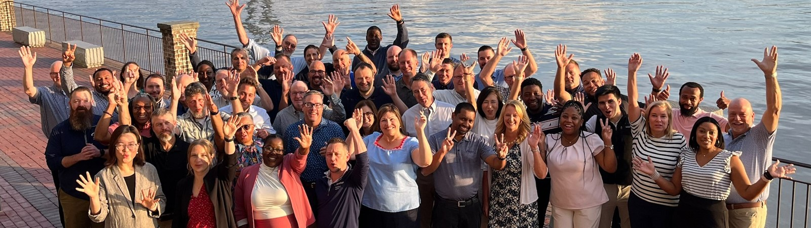
Our Culture
A career at Nordson is defined by opportunity – where entrepreneurial thinking, making an impact in your role and in your community, and global collaboration shape your path to success.
Nordson is a growing organization with a team of over 8,000 employees across the globe. With an innovative mindset and an entrepreneurial spirit, we connect with our team members and customers to create innovative precision technology solutions for essential products used in everyday life.
Empowering Possibilities

Slide 39
Our Values
In striving to reach its goals, Nordson remains committed
to a unique set of core values. Embedded with the Nord’s original vision
for the company, these values have since been articulated and reinforced
by succeeding Nordson leadership teams to this day.

Slide 40
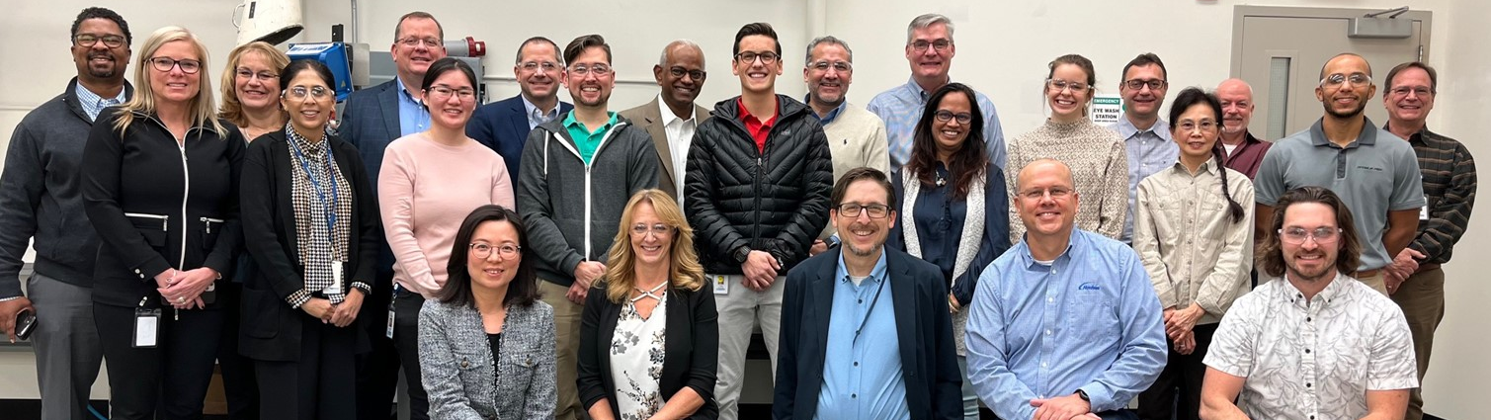
Integrity
We are honest with employees, customers, shareholders, the media and ourselves.
We will do what is right. We will not compromise standards.

Slide 41
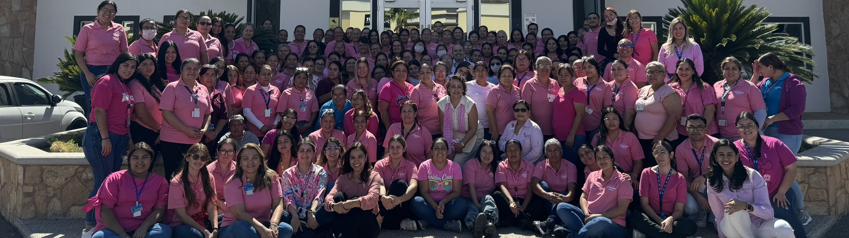
Respect for People
We value employees. We thrive on teamwork, collaboration and diversity.
We will not compromise safety. We communicate openly and honestly.
We give back to our communities.

Slide 42
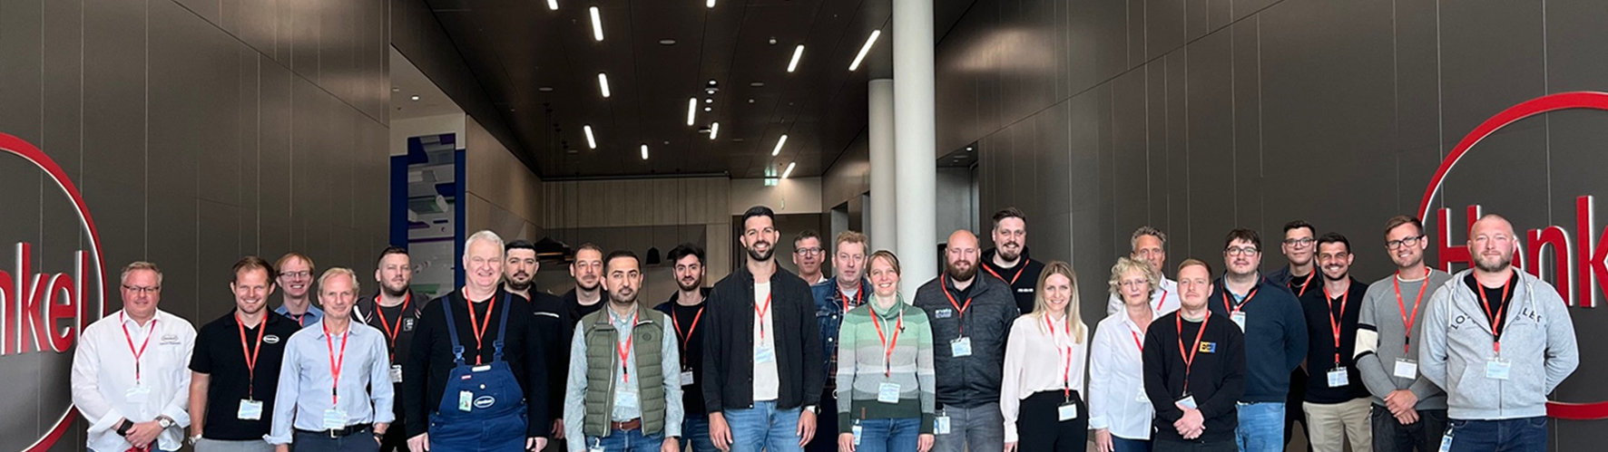
Customer Passion
We expect more from ourselves than our customers do.
Quality and service come first.

Slide 43
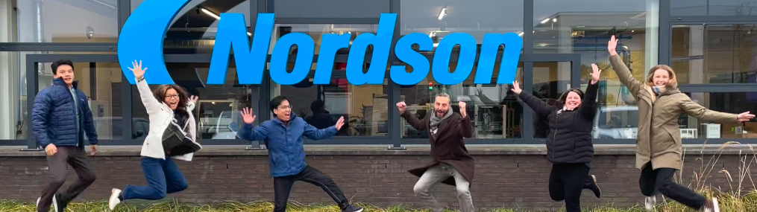
Energy
We approach challenges with an attitude of “lean forward, let’s get it done”.
Enthusiasm drives the pace of work.
We care… complacency is worse than our toughest competitor.

Slide 44
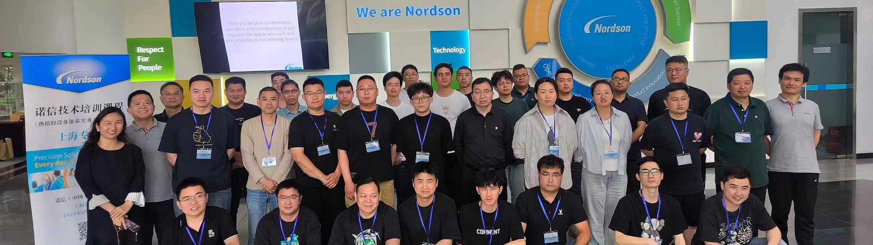
Excellence
We expect the best from management, co-workers and ourselves.
We are not satisfied with work that is “average” or “OK”.

Slide 45
Our Leadership

Slide 46
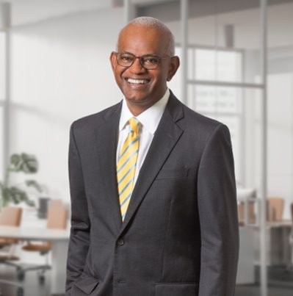
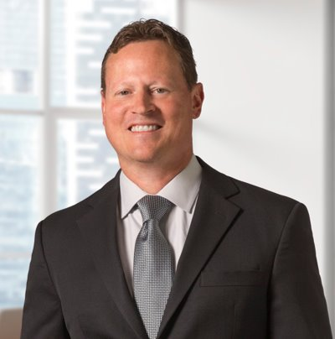
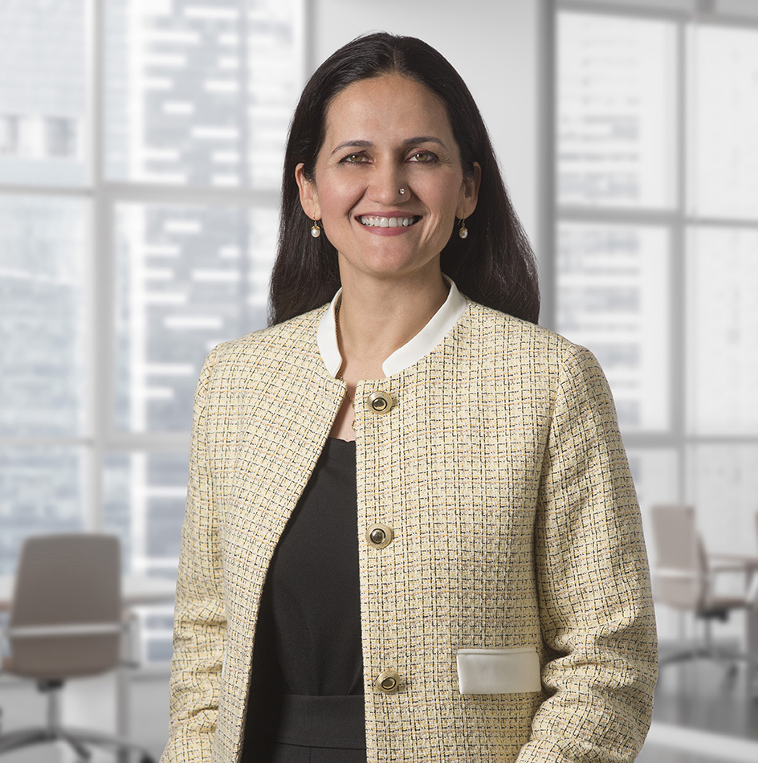
Our Leaders
Sundaram Nagarajan
Dan Hopgood
Sarah Siddiqui
President,
Chief Executive Officer
Executive Vice President, Chief Financial Officer
Executive Vice President, Chief Human Resources Officer

Slide 47
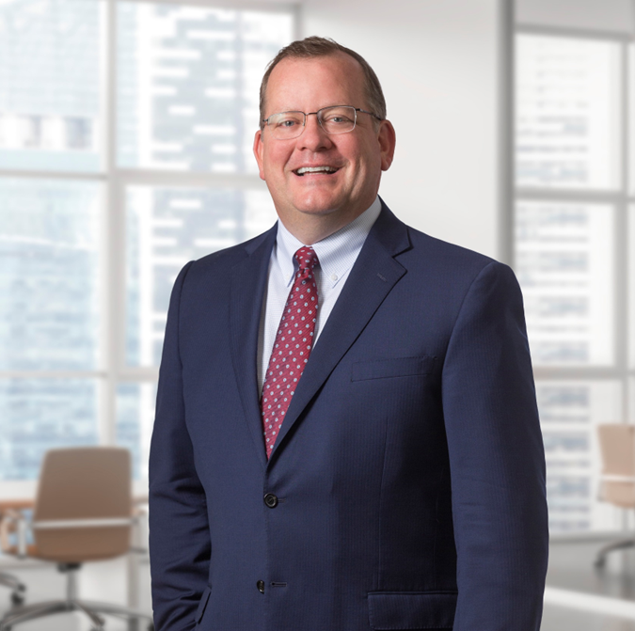




Our Leaders
Joe Kelley
Sundaram Nagarajan
Justin Hall
Executive Vice President, IPS
Executive Vice President, MFS

Slide 48



Our Leaders
Jennifer McDonough
Chelsey Young
Katie Colacarro
Executive Vice President, General Counsel
Vice President,
Enterprise Technology Solutions
Vice President,
Corporate Development

Slide 49
Our Board of Directors
Chairman of the Board:
Victor L. Richey, Jr.
Retired President and Chief Executive Officer
ESCO Technologies, Inc.
John DeFord
Executive Vice President and Chief Technology Officer
Becton, Dickinson and Company
Frank M. Jaehnert
Retired President and Chief Executive Officer
Brady Corporation
Ginger M. Jones
Retired Sr. Vice President and Chief Financial Officer
Cooper Tire & Rubber Company
Christopher L. Mapes
Executive Chairman, Retired President and Chief Executive Officer
Lincoln Electric Holdings, Inc.
Michael J. Merriman, Jr.
Business Consultant
Product Launch Ventures, LLC
Sundaram Nagarajan
President and Chief Executive Officer
Nordson Corporation
Dr. Milton Morris
Retired President and Chief Executive Officer
Neuspera Medical, Inc.
Jennifer Parmentier
Chief Executive Officer
Parker Hannifin Corporation

